Slide 1


NEXT GEN EMPLOYABILITY PROGRAM
CREATING A FUTURE-READY WORKFORCE
Student Name :
Marneni Roopesh
Student ID :
College Name :
INTERNSHIP_173951615267aee8f889303
Sri Indu College of Engineering & Technology

Slide 2
CAPSTONE PROJECT SHOWCASE
Project Title
E-Commerce Shopping Website using MERN Stack
Abstract | Problem Statement | Project Overview | Proposed Solution | Technology Used | Modelling & Results | Conclusion | Q&A

Slide 3
Abstract
1
This project presents a comprehensive full-stack e-commerce web application developed using the MERN stack—MongoDB, Express.js, React, and Node.js.
2
The platform enables users to seamlessly browse and purchase products, manage their shopping carts, and securely register or log into their accounts.
3
The frontend is built with React and utilizes Context API for global state management, providing a dynamic and responsive user experience.
Designed with scalability and modularity in mind, the system separates concerns across the frontend, backend, and database layers. This project lays a strong foundation for future enhancements, such as integrating payment gateways, admin panels, and advanced product search or filtering features.
4

Slide 4


Problem Statement
In today's digital age, consumers increasingly prefer the convenience of online shopping over traditional retail experiences. However, many small and mid-sized businesses struggle to establish a functional and user-friendly online presence due to the complexity and cost of existing e-commerce solutions.
Additionally, users often face issues such as insecure payment systems, limited product discovery, and poor cart or account management on underdeveloped platforms.
This project aims to address these challenges by developing a full-stack e-commerce solution using the MERN stack that includes features such as authentication, cart management, product uploading, and secure data handling—delivering both functionality and a smooth user experience.

Slide 5

Project Overview
This project is a full-stack E-Commerce Web Application built using the MERN stack—MongoDB, Express.js, React, and Node.js. It is designed to simulate the core functionalities of a real-world online shopping platform, offering both customers and administrators a smooth and interactive digital shopping experience.
To provide users with a modern, secure, and responsive online platform to browse, select, and purchase products, while enabling admins to efficiently manage inventory and track user activity.

Slide 6
Proposed Solution
To address the challenges faced by users and small businesses in managing and accessing efficient online shopping systems, we propose the development of a scalable, secure, and user-friendly e-commerce web application using the MERN stack (MongoDB, Express.js, React, Node.js).
Solutions:
User-Centric Frontend (React)
Secure Backend (Node.js + Express)
Robust Database (MongoDB)
Admin Functionalities
Efficient Cart Management
Outcome:
This solution will provide users with a seamless shopping experience and give admins full control over inventory management—making it a flexible foundation for small to mid-scale online stores. The architecture also supports future integrations like payment gateways, search filters, or order tracking.

Slide 7
Technology used
Frontend (Client-Side):
React.js
React Router
Context API
CSS & Inline Styling
Backend (Server-Side):
Node.js
Express.js
JWT (JSON Web Tokens)
Multer
Cors & Body-Parser
Database: MongoDB, Mongoose.
Development & Utilities: Postman, Nodemon, VS Code.

Slide 8
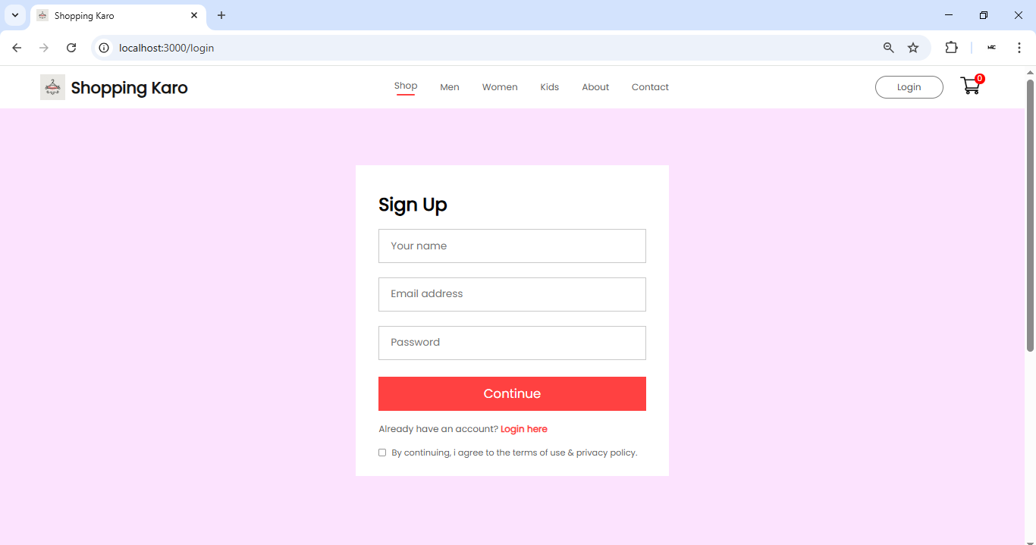
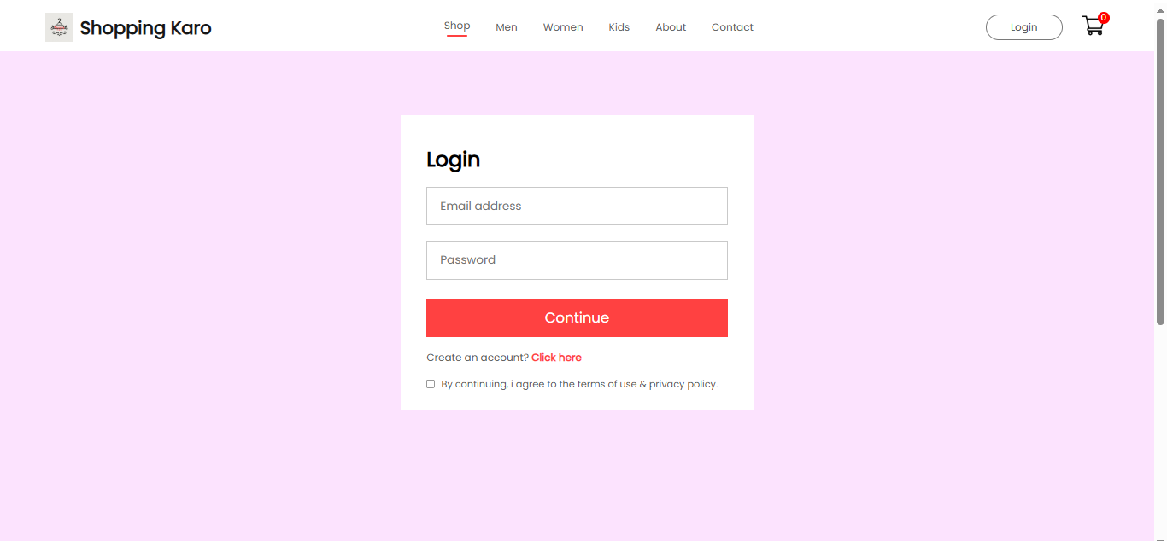
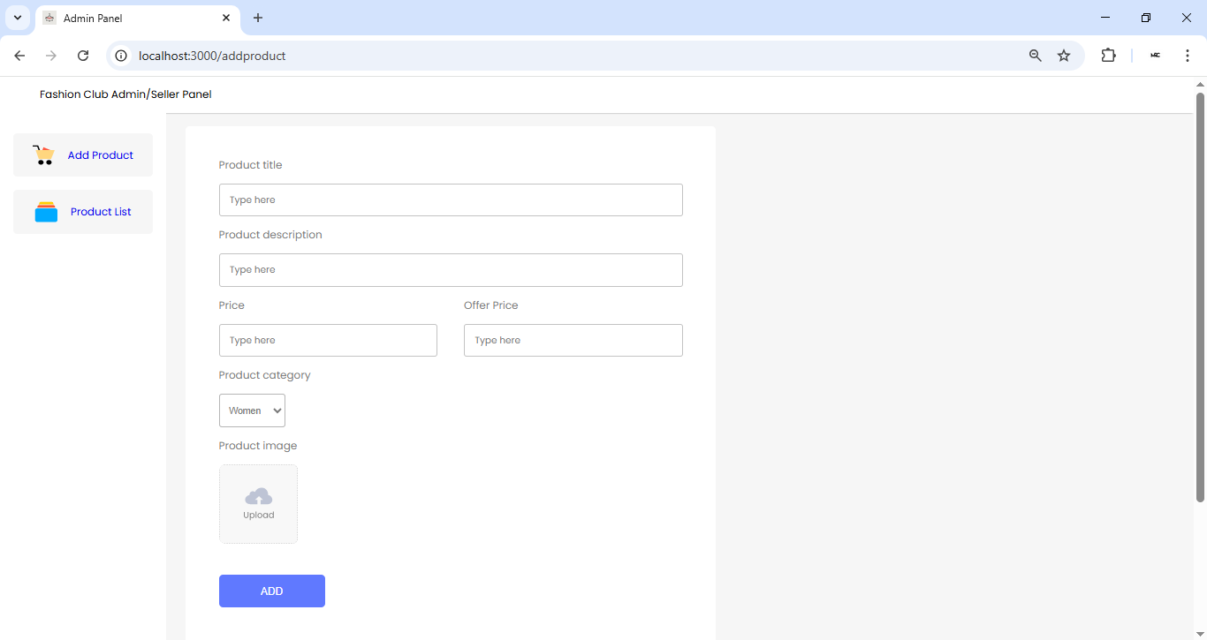
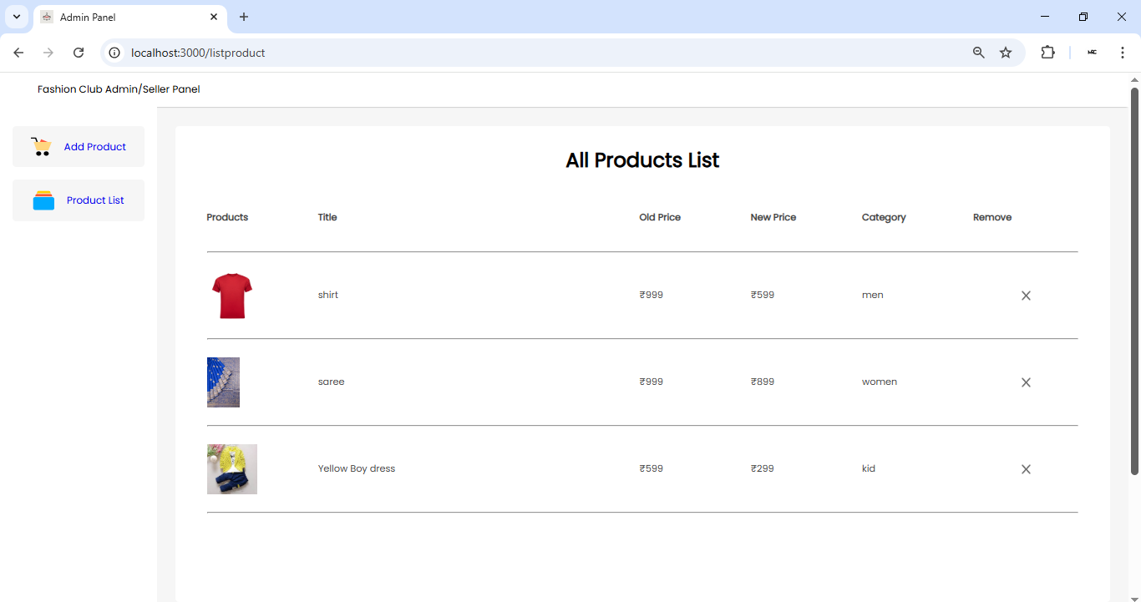
Modelling & Result
SignUp Page
Login page
Add Product Page
All Product List

Slide 9
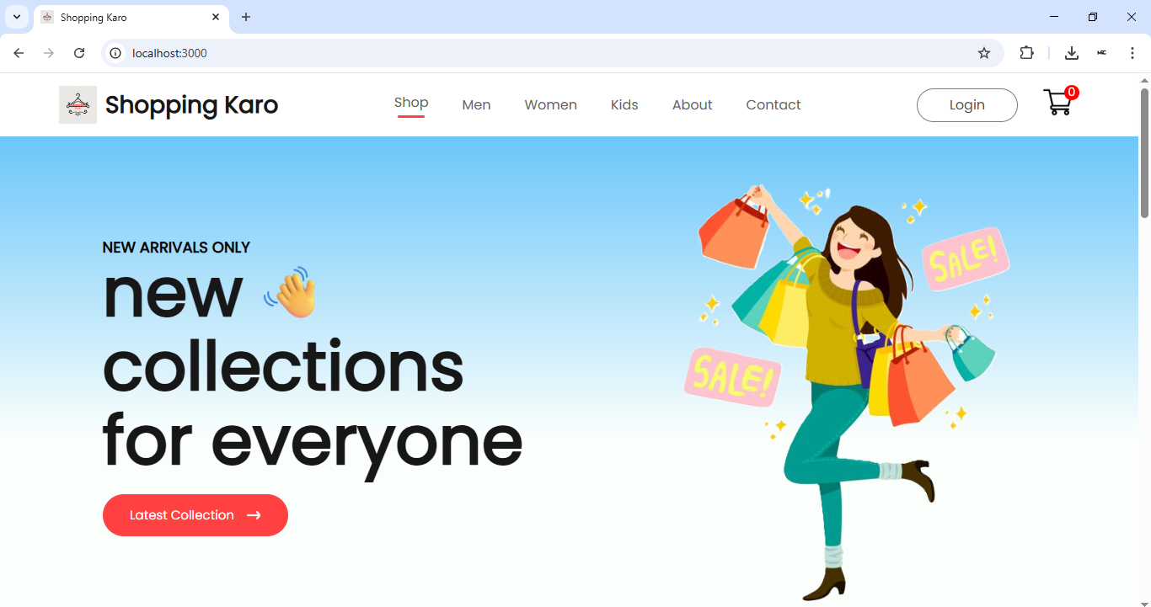
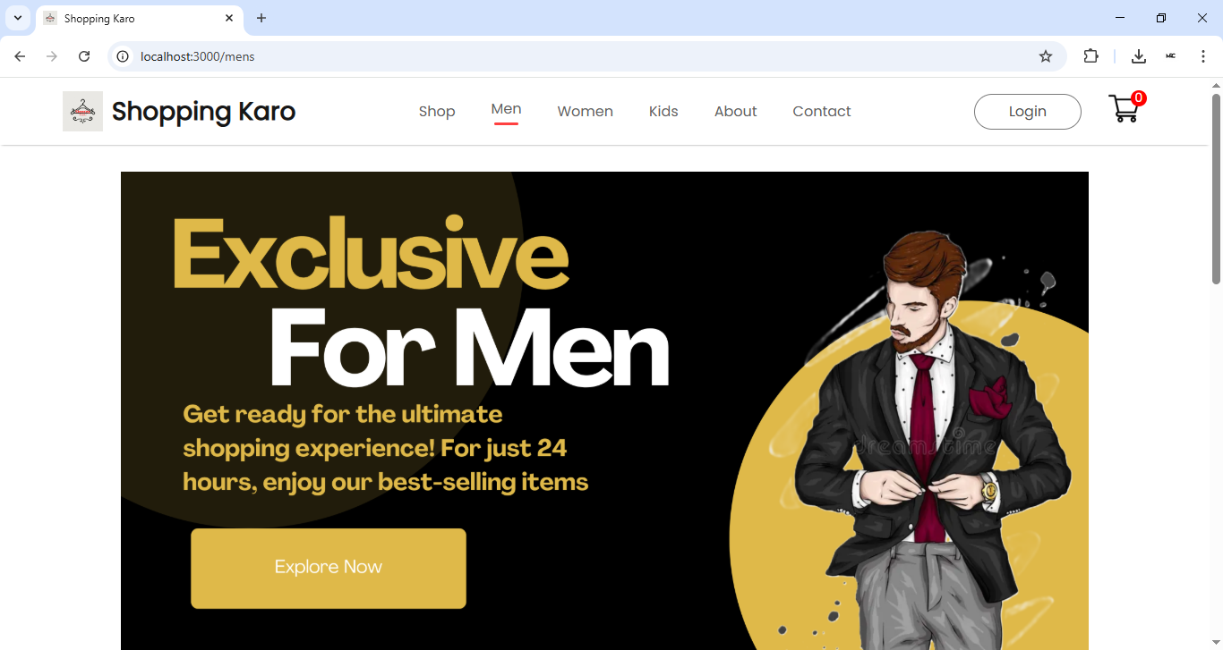
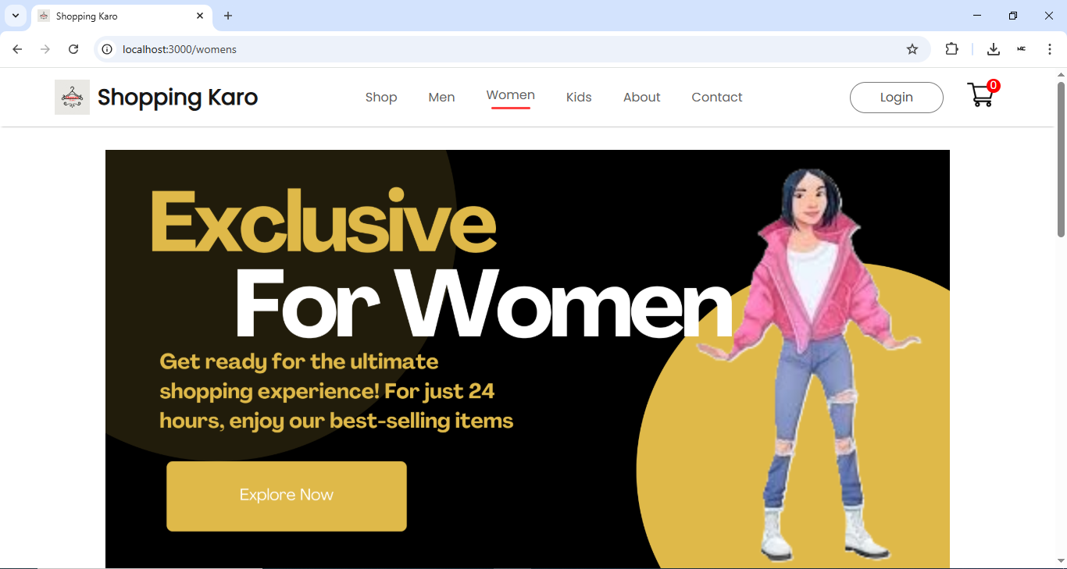
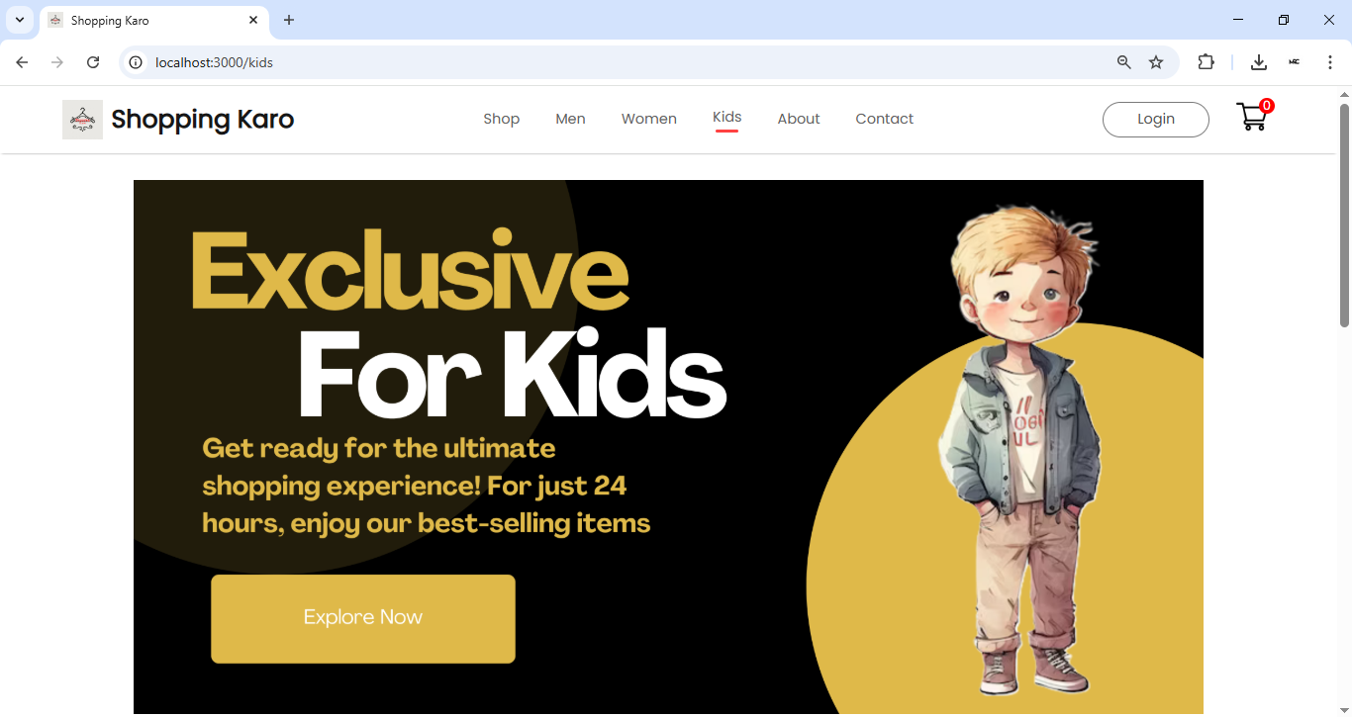
Modelling & Result
Home page
Men Category
Women Category
Kids Category

Slide 10
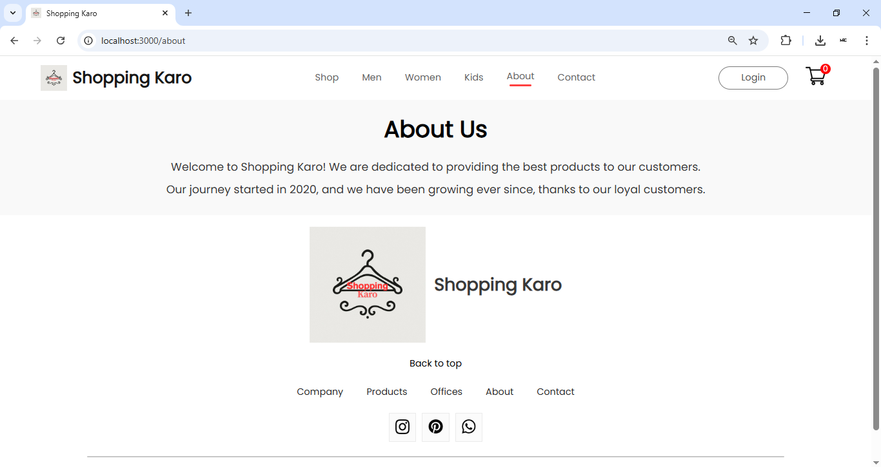
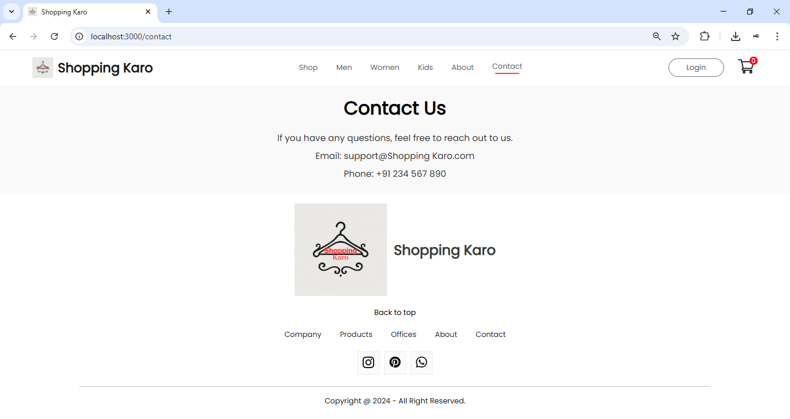
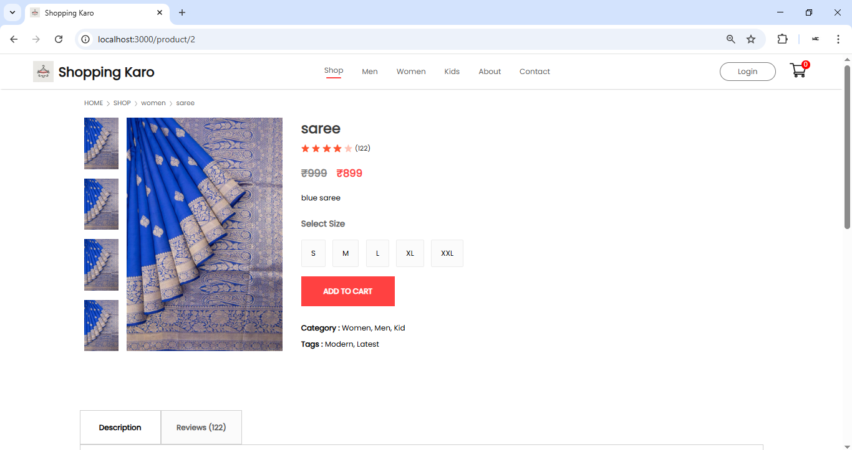
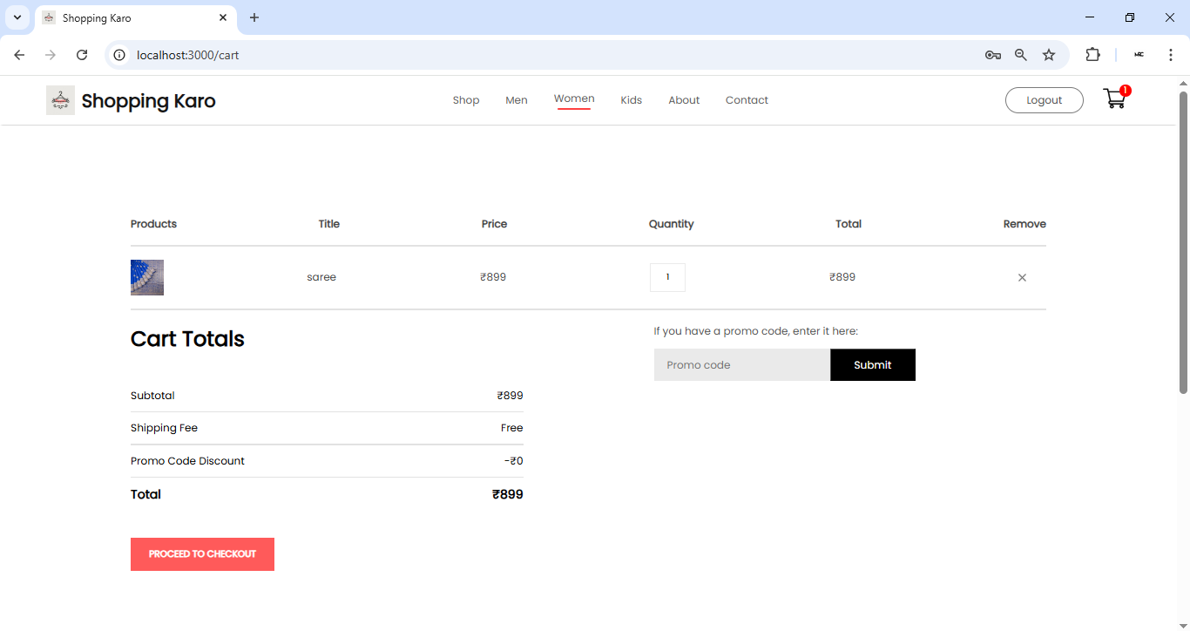
Modelling & Result
About Us Page
Contact Us
Cart Page
Check Out Page

Slide 11

Conclusion
The e-commerce web application developed using the MERN stack successfully demonstrates a full-stack solution for modern online shopping platforms. It integrates secure user authentication, dynamic product handling, and interactive cart management within a scalable and modular architecture.
The use of React and Context API ensures a seamless and responsive user experience, while Express.js and MongoDB provide a robust and secure backend.
This project showcases the practical implementation of full-stack development principles, emphasizing modularity, scalability, and security—making it a valuable foundation for real-world e-commerce solutions.

Slide 12


Notes:
Thank You !!

